Slide 1
Chapter 4: Classification
Machine Learning Refined: Foundations, Applications, and Algorithms Cambridge University Press (2016)

Slide 2
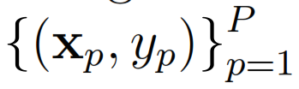
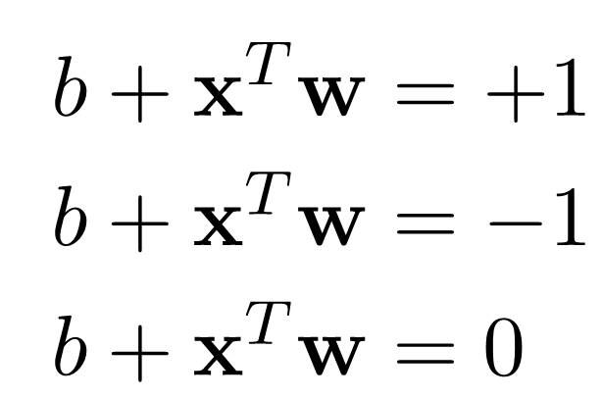
Linear classification setup
Data
Output (label): +1 or -1 (we’ll see multi-class soon)
Input: N-dimensional in general (here N = 2)
+1
+1
+1
+1
+1
-1
Goal: find proper values for and
-1
-1
-1
-1

Slide 3
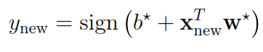
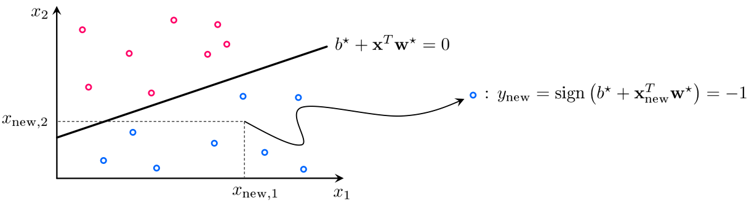
Classification of future data

Slide 4
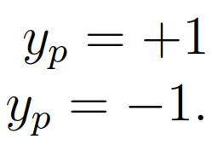
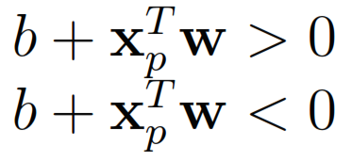
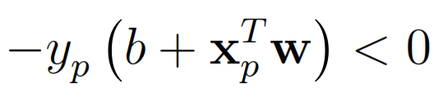

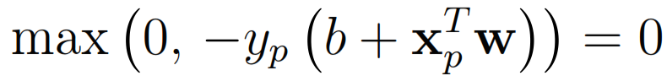
Perceptron
+1
+1
+1
+1
+1
-1
-1
-1
-1
-1

Slide 5
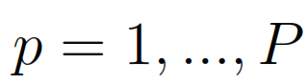
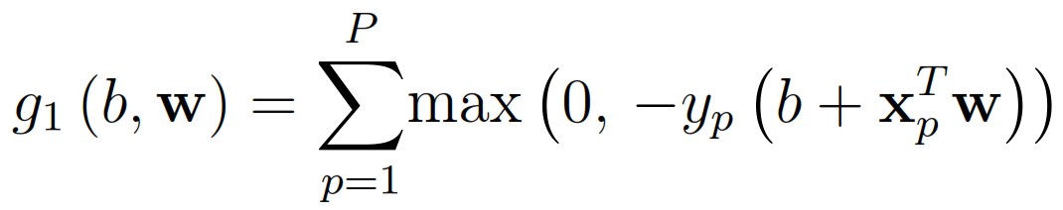
Perceptron
We want to hold for all
Perceptron cost:
Minimizing returns an optimal set of
and
+1
+1
+1
+1
+1
-1
-1
-1
-1
-1

Slide 6
What if data isn’t linearly separable?
Perceptron cost can still be employed!
Unlike the linearly separable case, the minimum of the perceptron cost is not zero
Notes:
wiggly.tif

Slide 7
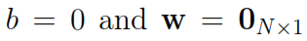
Optimization of the perceptron cost
Two unwanted issues:
One minimum always presents itself at the trivial and undesirable values
While being continuous and convex, the perceptron cost is not everywhere differentiable, prohibiting the use of gradient descent/Newton’s method out of the box for its minimization
Notes:
wiggly.tif

Slide 8
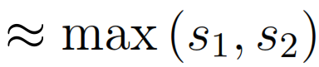
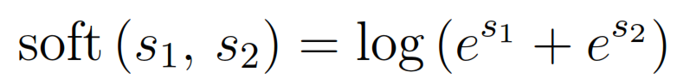
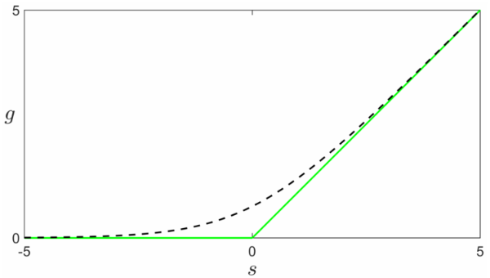
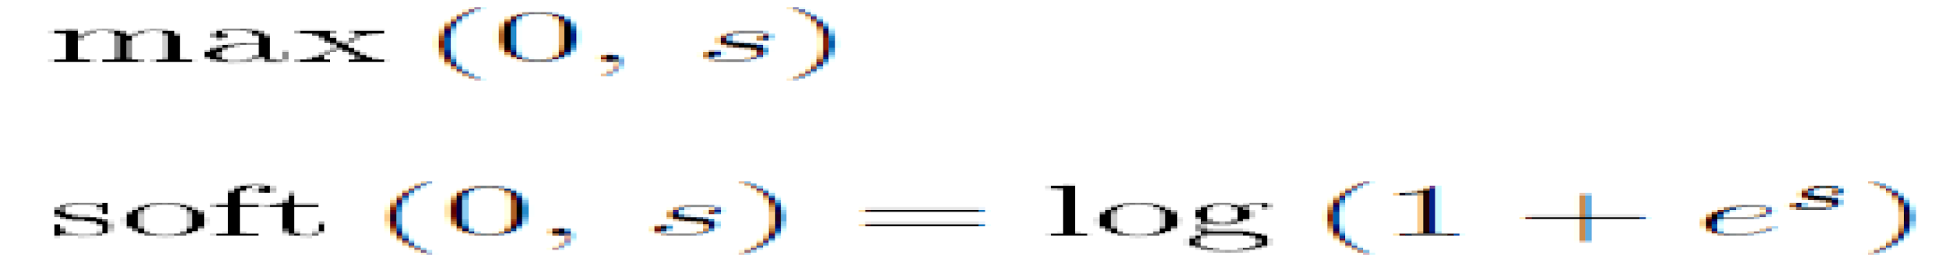
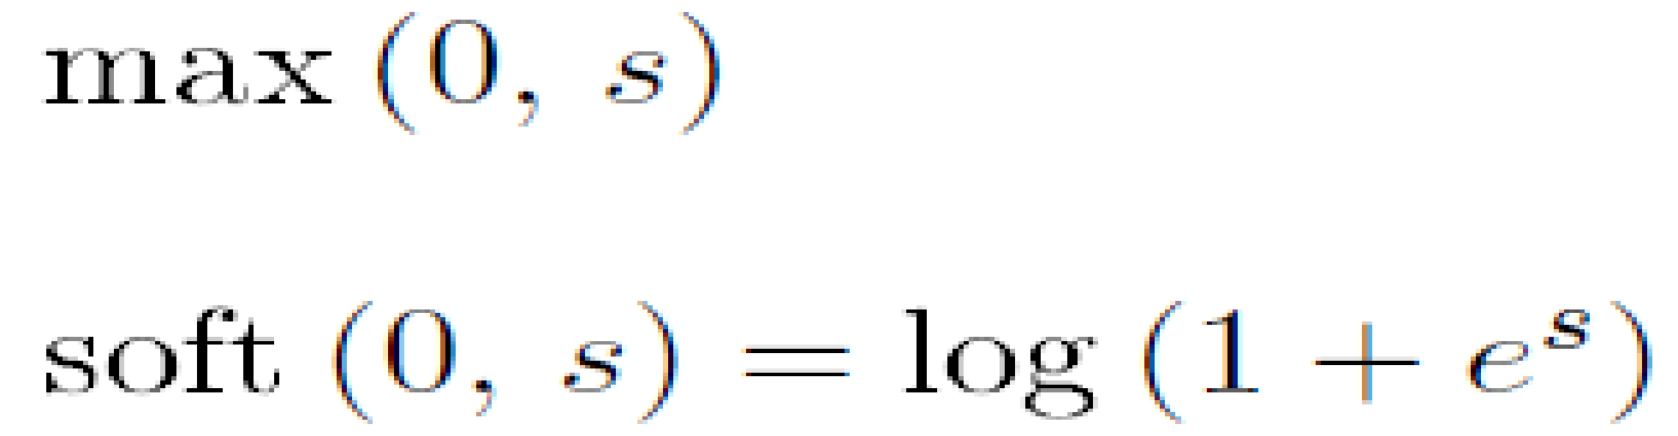
The softmax perceptron
Both issues w/ the perceptron cost can be resolved by replacing the non-differentiable max function with the smooth softmax function defined as
Notes:
wiggly.tif

Slide 9
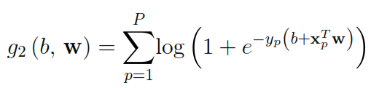
The softmax perceptron
original perceptron:
softmax perceptron:
The original perceptron is also referred to as the hinge due to its shape
The softmax perceptron is usually known by the name of logistic regression classifier in the ML community

Slide 10
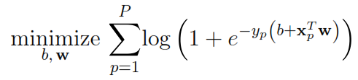
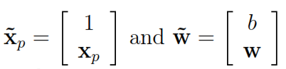
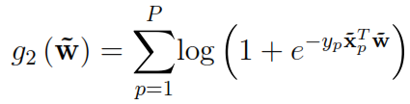
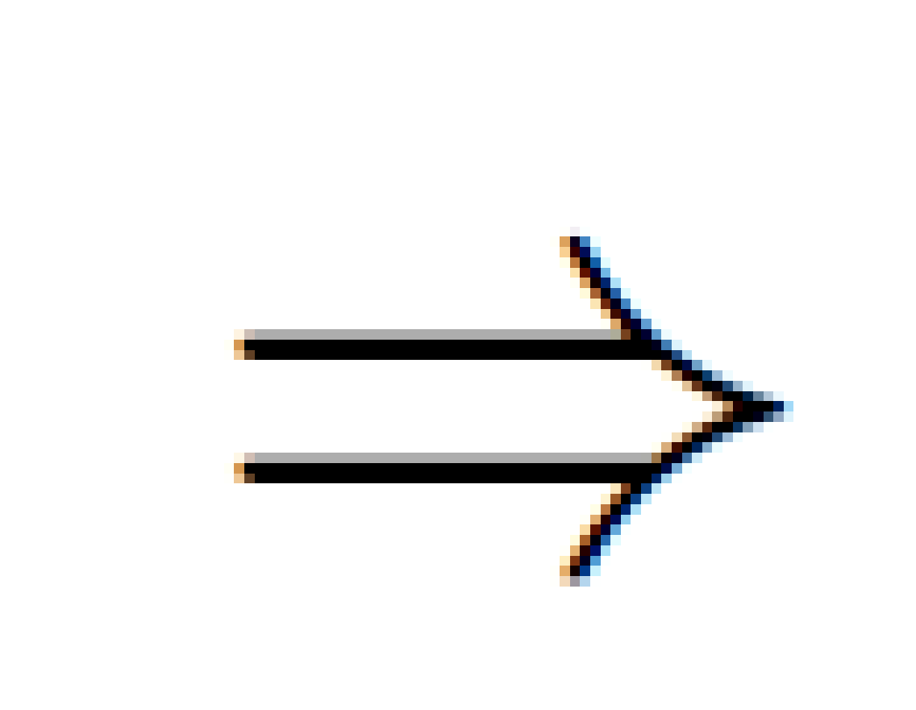
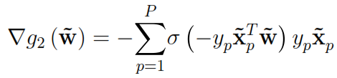
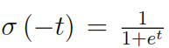
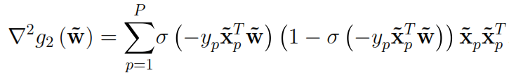
Optimization of the softmax perceptron
Define
Gradient:
where
Hessian:

Slide 11
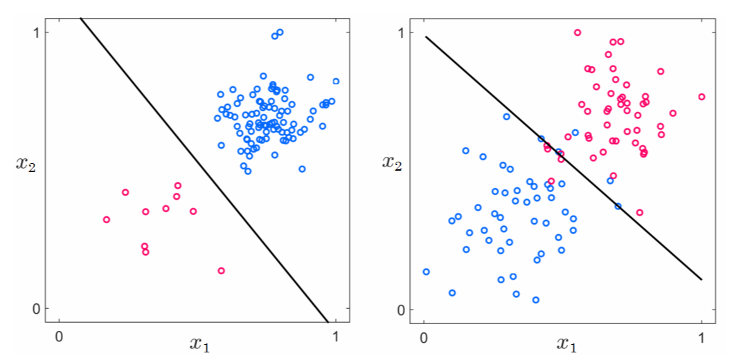
The softmax perceptron

Slide 12
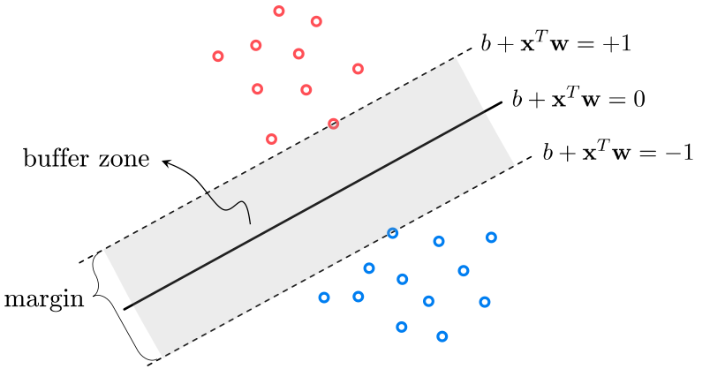
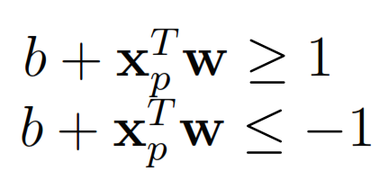
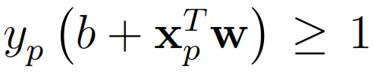
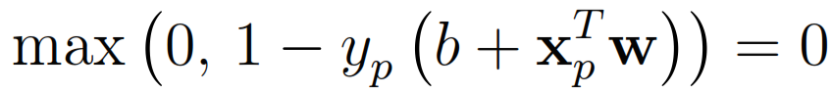
The margin perceptron

Slide 13
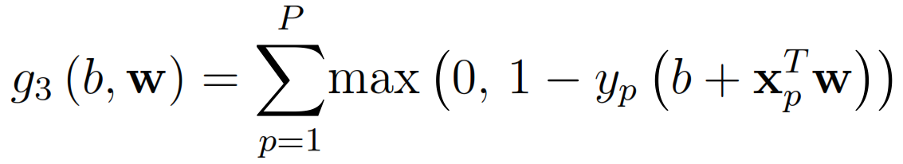
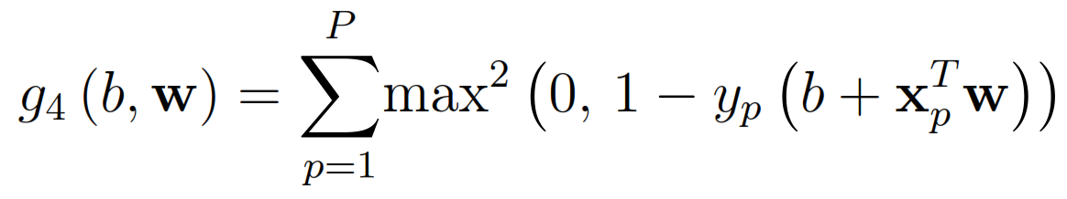
The (squared) margin perceptron
The margin perceptron doesn’t have the issue of trivial minimum at zero but is still non-differentiable
We could once again approximate the max function with softmax, by replacing each summand with
An alternative way is to replace each summand with its squared version, resulting in the squared margin perceptron cost function

Slide 14
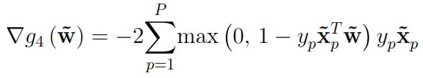
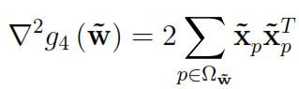
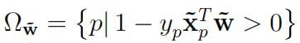
Optimization of the squared margin perceptron
Define
Gradient:
Hessian:
where

Slide 15
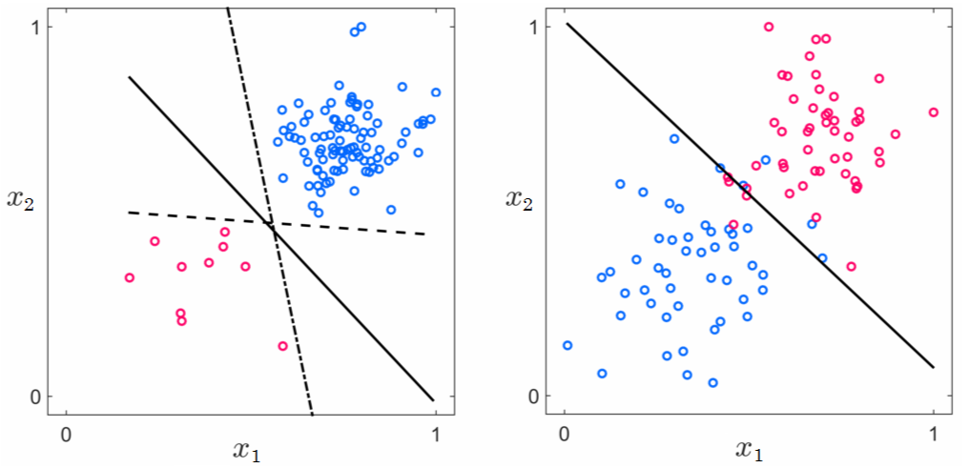
The squared margin perceptron

Slide 16
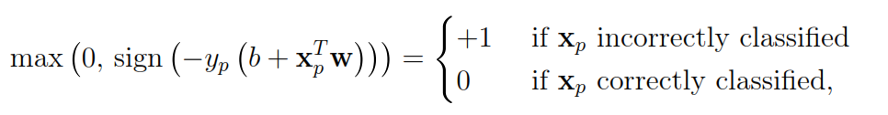
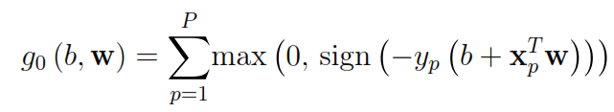
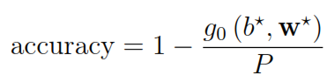
Classification accuracy
One way of evaluating the performance of a learned classifier is to count the number of points that end up on the wrong side of the classifier
Summing the expression above over the entire dataset gives the total number of incorrectly classified points, also known as the counting cost
A metric called the classification accuracy uses the counting cost to determine the ratio of correctly classified points in the dataset, defined as

Slide 17
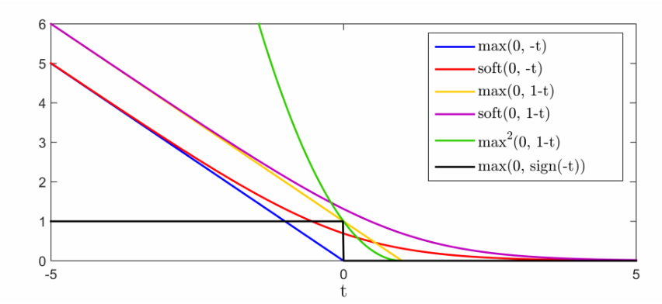
Perceptrons as surrogates of the counting cost
perceptron
softmax perceptron
margin perceptron
soft margin perceptron
squared margin
counting cost

Slide 18
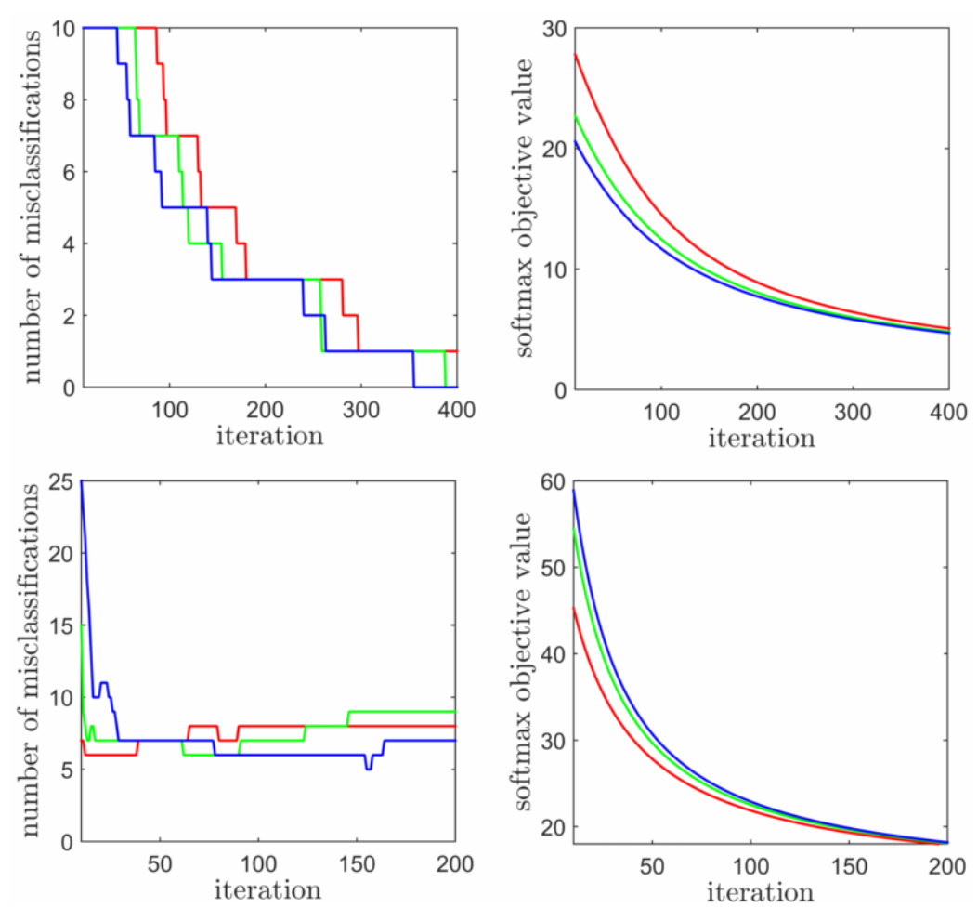
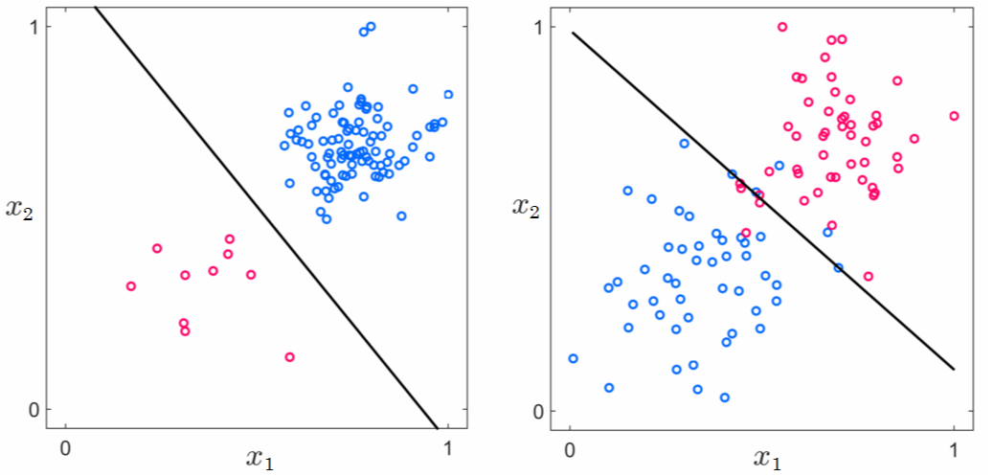
Perceptrons as surrogates of the counting cost

Slide 19
Perceptrons as surrogates of the counting cost

Slide 20
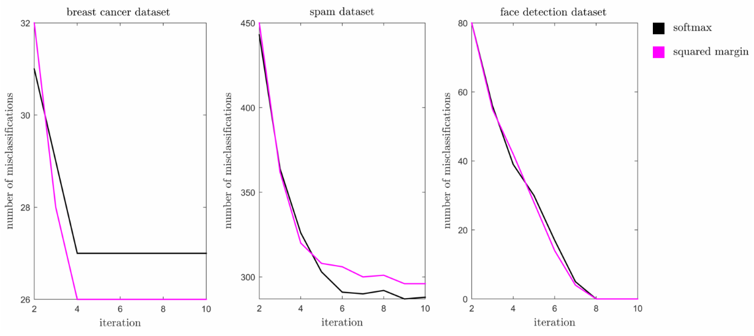
Softmax vs. squared margin perceptron

Slide 21
Logistic Regression

Slide 22
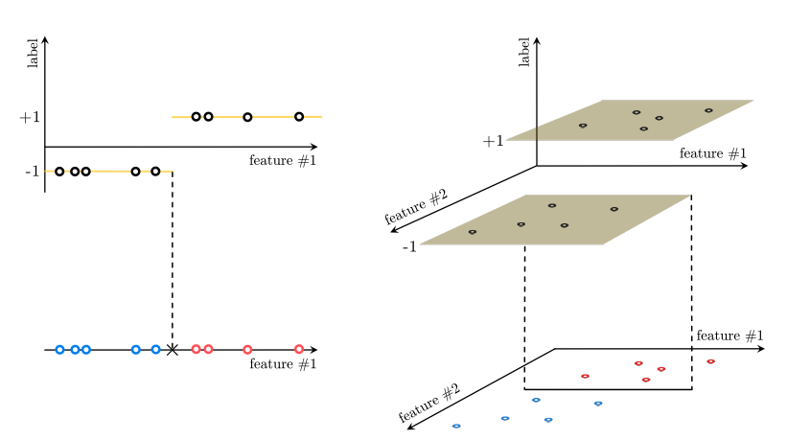
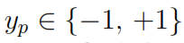
The logistic regression perspective on softmax perceptron
Binary classification can be geometrically
viewed as a particular instance of regression
In this case the output is discrete, taking on
two fixed values
From a regression perspective, linear classification
is equivalent to fitting a step function to the given data
1-D input

Slide 23
The logistic regression perspective on softmax perceptron
Binary classification can be geometrically
viewed as a particular instance of regression
In this case the output is discrete, taking on
two fixed values
From a regression perspective, linear classification
is equivalent to fitting a step function to the given data
2-D input

Slide 24
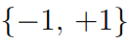
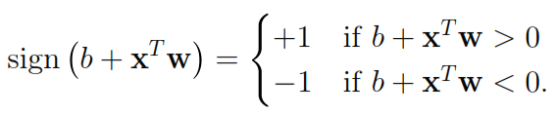
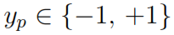
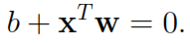
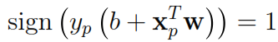
Defining a step function
A step function taking values on can be
written explicitly as
With the choice of
can be compactly written as

Slide 25
Defining a step function
A step function taking values on can be
written explicitly as
With the choice of
can be compactly written as

Slide 26
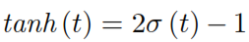

A smooth approximation to the step function

Slide 27




tanh fitting
Approximating the sign function with tanh, the criterion for correct classification
becomes
or equivalently
Taking the log of both sides yields
giving the logistic regression problem as
Softmax perceptron

Slide 28

Linear classification: the two perspectives

Slide 29



Linear classification: the two perspectives

Slide 30
Support Vector Machines

Slide 31

The SVM perspective on margin perceptron
When data is separable, there are infinitely many solutions to the margin perceptron problem
Support Vector Machines suggests to choose the hyperplane with maximal margin

Slide 32



Margin length calculation

Slide 33

Quest for the maximum margin classifier
Invesrsely proportional to margin length
All points should end up on the right side of the classifier
Typically referred to as the hard margin SVM problem
A simple instance of a Quadratic Program
Infeasible when the data isn’t linearly separable!

Slide 34

Hard margin SVM: demo

Slide 35

Soft margin SVM
Data in practice usually isn’t separable, ruling out application of the hard margin SVM model
The hard margin problem can be modified by ‘relaxing’ the constraints to allow for possible violations of linear separability
One popular way of relaxing the constraints is by adding up all of them and bring the sum to the objective, giving the soft margin SVM cost function
Controls the trade-off between how well we satisfy the original constraints while seeking a large margin
Margin perceptron cost
L2 regularizer

Slide 36


A final note on logistic regression and SVMs
Soft margin SVM:
(basically, L2 regularized margin perceptron)
Log-loss SVM:
(basically, L2 regularized logistic regression)

Slide 37
Multi-class Classification

Slide 38





Multi-class classification
Hand-written digit recognition
Face recognition
Speech recognition
Hand-gesture recognition
…
Data:

Slide 39



One vs. All (OvA) classification
To perform OvA on a dataset with C classes:
Learn C individual classifiers, each distinguishing one class from the rest
Combine these classifiers using the fusion rule

Slide 40

Multi-class softmax classification
Unlike OvA with multi-class softmax, the C individual classifiers are learned jointly using a single cost function
Like OvA, the learned parameters are combined using the fusion rule to arrive at the final classification
OvA
Softmax

Slide 41


Multi-class softmax: Derivation
Always non-negative Ideally zero We have a cost function!

Slide 42



Multi-class softmax: Derivation
Employing the smooth softmax approximation to the ‘max’ function
gives the multi-class softmax cost function

Slide 43


Multi-class softmax: Derivation
With simple algebraic manipulation, multi-class softmax cost can be written in many equivalent forms
(a.k.a softmax regression)
When C=2, multi-class softmax reduces to two-class softmax perceptron/logistic regression

Slide 44



Multi-class softmax: Optimization
Defining
and
Gradient:

Slide 45

Multi-class softmax: demo

Slide 46
Knowledge-driven
Feature Design

Slide 47




Nonlinear separation

Slide 48

Full view of data

Slide 49






Histogram features
TEXT
IMAGE
AUDIO
Sentiment analysis
Spam detection
Document clustering
…
Pedestrian detection
Face detection
OCR
…
Speech recognition
Speaker recognition
Music discovery
…

Slide 50


Histogram features
. . .
. . .
. . .
words
edge content
frequency

Slide 51

Bag of Words (BoW) histogram
1) dogs are the best
2) cats are the worst
Parsing
dogs / are / the / best
cats / are / the / worst
Stop word removal
dogs / are / the / best
cats / are / the / worst
Stemming
dogs best
cats worst
Merging
best cat dog worst
Normalized vector representation

Slide 52




Sentiment analysis with BoWs
One of the funniest films you will ever feel this uncomfortable about laughing out loud at. Remember if you laugh, the terrorists win!
It is rude and raunchy, and it has a message, sort of. You have to wade through an awful lot of obscenity to get to it though.
Kevin Ranson
MovieCrypt.com
Roger Moore
Orlando Sentinel

Slide 53

Spam detection
Frequency of certain characters like ‘ ! ’ and ‘ * ’
Percentage of capital letters
Length of longest uninterrupted
sequence of capital letters
…

Slide 54

Image histogram features: pixel values or edge orientations?
dissimilar
similar
similar
dissimilar

Slide 55


Face detection: raw pixels vs. histogram features

Slide 56

Histogram of Oriented Gradients

Slide 57

Audio features
Speech signal

Slide 58

Spectrogram

